Slide 1

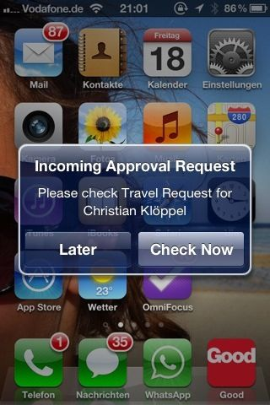
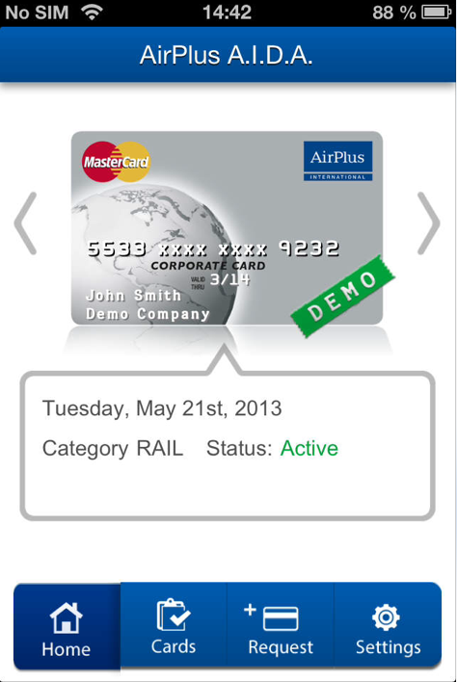
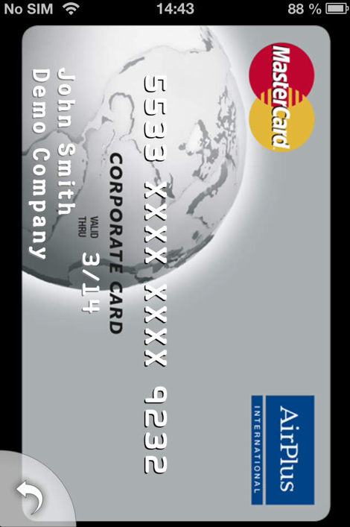
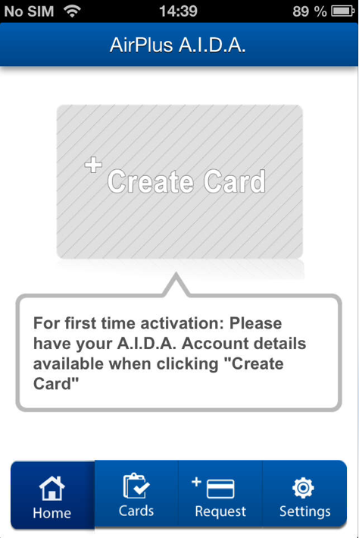
Case Study: AirPlus – Mobile A.I.D.A. / Temporary Credit Cards
Client
AirPlus is a leading international provider of business travel management solutions and is constantly expanding and innovating its solution portfolio.
Challenge
Solution
Results
The AirPlus A.I.D.A. product supports business travelers with instant virtual credit cards for single use at merchants who do not accept UATP credit cards.
A.I.D.A. cards needed to be printed from a pdf file resulting in inconvenient handling.
Mobile A.I.D.A. should optimize the handling of these cards while retaining high security standards (PCI, Encryption, Data Security)
Mobile A.I.D.A. is a cross platform mobile phone application to request and receive AirPlus A.I.D.A. cards instantly anywhere, anytime (network coverage required)
Secure storage on the device using AES-256 encryption and PIN code verification.
Mobile A.I.D.A. users are now able to request new cards from their phone anywhere & anytime
Card can be shown full-screen at merchant
Manage several cards in a convenient card carousel
iOS (iPhone) and Android Application in AirPlus corporate aligned design
Visit csc.com/mobility for more information

